Slide 2

Pseudocodes -> Flowcharts -> Algorithms-> Programs
Notes:
This presentation demonstrates the new capabilities of PowerPoint and it is best viewed in Slide Show. These slides are designed to give you great ideas for the presentations you’ll create in PowerPoint 2010!
For more sample templates, click the File tab, and then on the New tab, click Sample Templates.

Slide 3
Learning Outcomes
To learn how to analyze a problem and build logic to solve it.

Slide 4
Pseudocode
Pseudocode
Informal description in plain English
No strict syntax
Rough draft of program
No need of programming knowledge

Slide 5
Write steps for making a cup of tea..
Fill kettle with water
Switch Kettle on
Wait until water in kettle boils
Put tea in Pot
Put boiling water in Pot
Wait 2 minutes
Put milk in cup
Pour tea in cup
Put 1 sugar lump in cup
Stir tea in cup
Serve Cup of tea
Pseudocode

Slide 6
Write pseudocode for calculating percentage
Note down the marks of all subjects.
Calculate the number of subjects.
Add the marks.
Calculate total maximum marks by multiplying maximum marks by number of subjects.
Divide the sum of marks with total maximum marks and multiply by 100.
You will get the percentage.

Slide 7
Write pseudocode for driving a car
Insert the key.
Start the car.
Check the Handbrake if it's still applied.
If it is, then release the handbrake of the car.
Step on the clutch of the car.
Then put your car into first gear without releasing the clutch.
Then slowly release the clutch while slowly stepping on the accelerator.
Then Go! Drive!!

Slide 8
Searching an entry in phonebook
Counting the number of students pass or fail
Check whether attendance criteria is fulfilled
Painting Wall
Design Pseudocodes for the following cases

Slide 9
Designing Pseudocodes for Programs

Slide 10
Writing Pseudocodes
Mathematical Operators
Assignment (=,:=),
Keywords
START, BEGIN-END, INPUT, READ, PRINT, DISPLAY, CALCULATE, COMPUTE, SET, INCREMENT, DECREMENT
Functions
Breakdown concept in block, reuse code
Start with keywords “Function function-name” and end with “EndFunction”, describe functionality in between
Comparison (<,>,<=,>=,==),
Arithmetic (+,-,*,/,**,^,%,*=,+=,-=,/=,++,--), ->,<-
Call function using “call: functionname”

Slide 11

Pictorial view of statements

Slide 12
Writing Pseudocodes contd.
Conditionals
execute instructions depending on whether the expression evaluated to True or False.
Iteration
Exception Handling
event which disrupts the normal flow of the instructions.
IF-ELSE IF-ELSE, CASE
Start with keyword EXCEPTION
repeat a set of instructions in order to generate a sequence of outcomes.
FOR, WHILE

Slide 13
Rules for writing Pseudocodes
Arrange sequence of tasks
Indent statements in case of loops
Use appropriate naming convention
Use appropriate sentence casing
Elaborate everything
Don’t use technical terms
Start with statement of main goal

Slide 14
Let’s start writing more Pseudocodes

Slide 15
Pseudocode 1: To implement addition of two numbers and displaying result
Start Program Enter two numbers A, B Add the numbers together Print Sum
End Program

Slide 16
Pseudocode 2: To compute the perimeter of rectangle
Start Program Enter length, l
Enter width, w
Compute Perimeter = 2*l + 2*w
Display Perimeter of a rectangle
End Program

Slide 17
Pseudocode 3: Ask a user to enter a number. If the number is between 0 and 10, write the word blue. If the number is between 10 and 20, write the word red. if the number is between 20 and 30, write the word green. If it is any other number, write that it is not a correct color option.
Start Program INPUT a number
READ colornum
IF(colornum >0 and colornum <= 10)
Write blue
ELSE IF (colornum >10 and colornum <= 20)
Write red
ELSE IF (colornum >20 and colornum <= 30)
Write green
ELSE Write "not a correct color option"
End Program

Slide 18
Pseudocode to print all multiples of 5 between 1 and 100 (including both 1 and 100).
Pseudo code that will count all the even numbers up to a user defined stopping point.
Pseudo code that reads in three numbers and writes them all in sorted order
Pseudocode to compute Fibonacci numbers till 50.
Pseudocode to compute factorial of a number
Write pseudocodes for the following

Slide 19
Advantages of Pseudocodes
Easily modified
Implements structured concepts easily
Read, written, understandable easily
Converting to programming language is easy
Clarify algorithms
Increases product reliability
Trap defects before they become code
Decreases overall costs

Slide 20
Disadvantages of Pseudocodes
Not visual
May require tool to extract pseudocode and facilitate sequential diagram.
Not get picture of design
No standard style or format

Slide 21
FLOWCHARTS

Slide 22
What is Flowchart?
Flowchart
Diagram depicting process, system or computer algorithm
Graphical representation of steps
Display information and assist reasoning.
Clear and easy to understand diagrams

Slide 23
Symbols used in Flowchart
Terminator
Document
On-page connector/reference
Flow
Process
Data
Off-page connector/
reference
Decision
Comment/Annotation
Database
Predefined Process

Slide 24
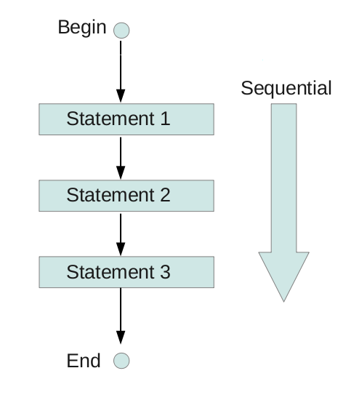
CASE 1: SEQUENTIAL STRUCTURE

Slide 25
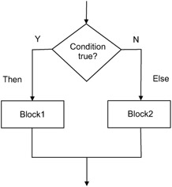
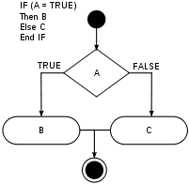
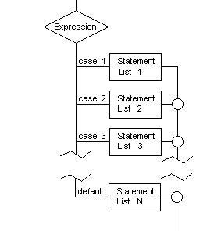
CASE 2: SELECTION STRUCTURE
IF-ELSEIF-ELSE
SWITCH CASE

Slide 26
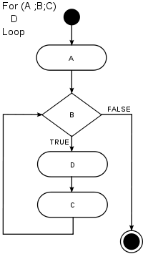
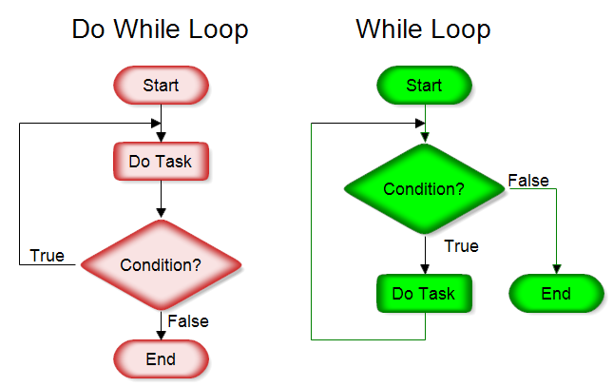
CASE 3: ITERATION STRUCTURE

Slide 27
Let’s design Flowcharts

Slide 28
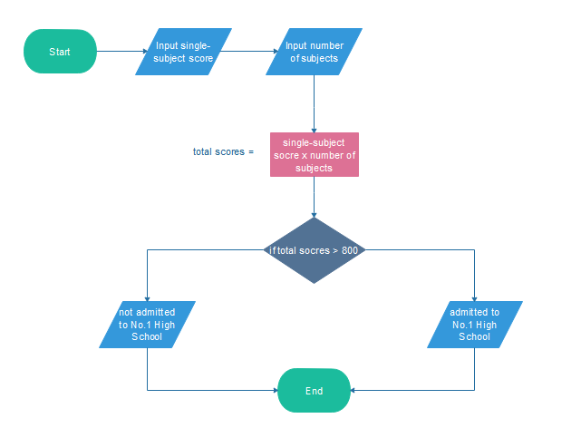
Flowchart 1: Am I Admitted to No.1 High School?

Slide 29
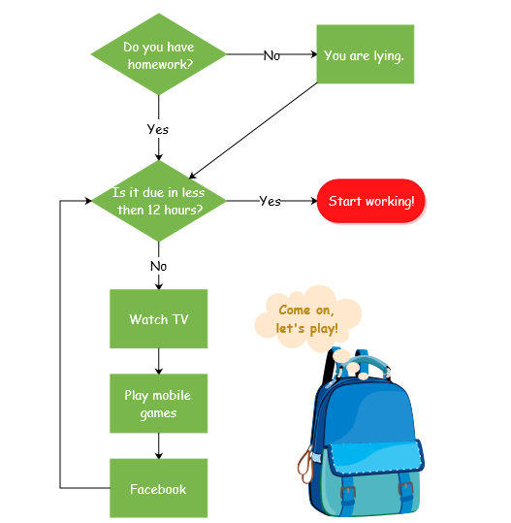
Flowchart 2: Should I do my homework now?

Slide 30
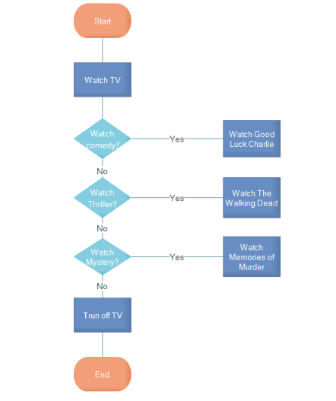
Flowchart 3: What Kind of series should I watch?

Slide 31
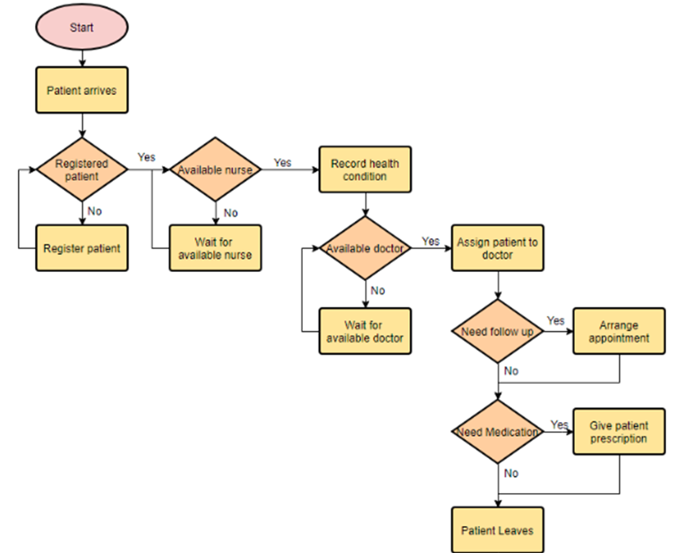
Flowchart 4: Medical services

Slide 32
Did I pass the test?
Shopping for the new dress
Driving a car
Looking for lost item
Divide age bracket into child, adult and teenager.
Design flowcharts for the following

Slide 33
Designing Flowcharts for Programs

Slide 34
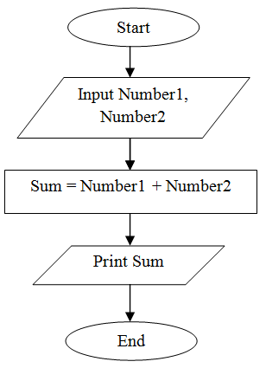
Flowchart 1: To add two numbers entered by user

Slide 35
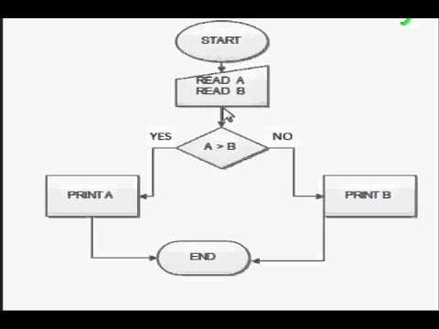
Flowchart 2: To input two numbers from user and display the largest of two numbers

Slide 36
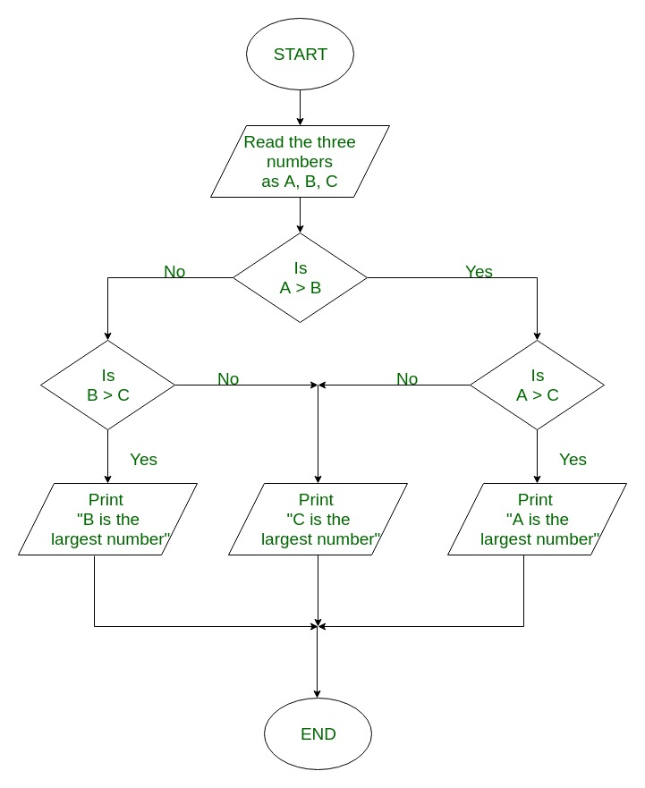
Flowchart 3: To find the largest among three different numbers entered by user

Slide 37
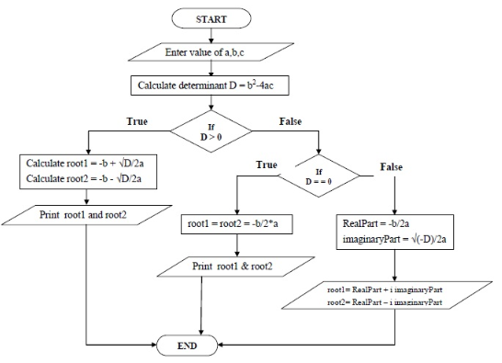
Flowchart 4: To find all the roots of a quadratic equation ax²+bx+c=0

Slide 38
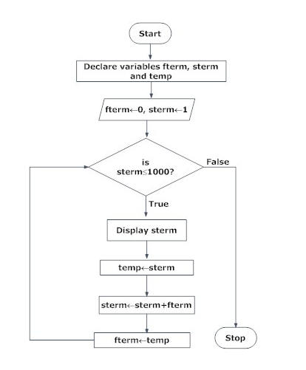
Flowchart 5: To find the Fibonacci series till term≤1000.

Slide 39
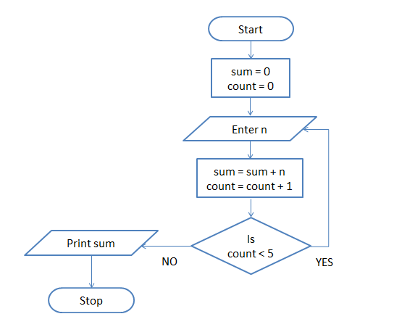
Flowchart 6: To find the sum of 5 numbers

Slide 40
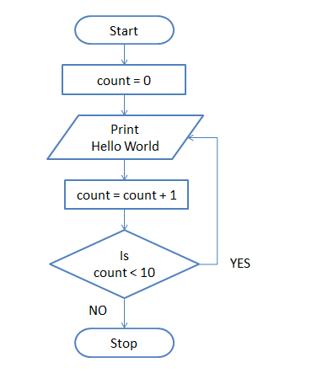
Flowchart 7: To print Hello World 10 times

Slide 41
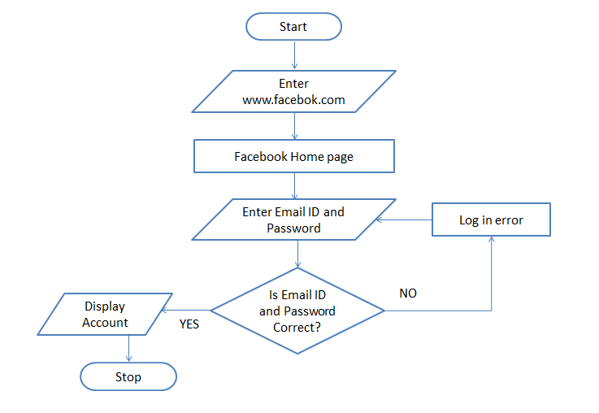
Flowchart 8: To log in to Facebook account

Slide 42
Calculate profit and loss
Online shopping
ATM transaction
Add all even numbers upto 100
Display all prime numbers
Factorial of a number
Design Flowcharts for the following

Slide 43
Communication
Proper documentation
Effective analysis
Advantages of Flowcharts
Efficient coding
Proper program maintainence
Proper debugging

Slide 44
Alterations and modifications
Complex logic
Reproduction
Disadvantages of Flowcharts
Costly
subjective
Time consuming

Slide 45
Algorithms

Slide 46
Differentiate Algorithms and Pseudocodes
Algorithm is a step by step procedure to solve a problem.
It helps to simplify and understand the problem.
It involves the high-level language builds which cannot be understood by a non-technical person.
Involves complicated programming language and its constructs.
Complex to construct and debug relative to pseudocodes.
Pseudocode is an informal way of writing a program.
It is a method of developing an algorithm.
It is a more plain and human understandable form of algorithm .
Pseudocode is easy to understand and interpret as compared to an algorithm.
Pseudocode is easily constructed and debugged relative to the algorithm.

Slide 47
Qualities of Good Algorithm
Input and output should be defined precisely
Results of each step are uniquely defined
Algorithm receives input, produces output and applies to a set of inputs
Each step should be clear and unambiguous.
Most effective to solve a problem
Shouldn't have computer code
Stops after a finite number of instructions are executed.

Slide 48


Slide 49
Lets make algorithms

Slide 50
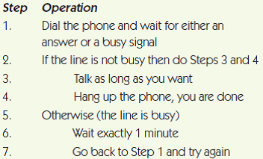
Algorithm 1: Calling a friend on telephone

Slide 51
Algorithm 2: To log onto Facebook account
Enter www.facebook.com in your browser. (I/O)
Facebook Home page loads (PROCESS)
Enter your Email ID and Password (I/O)
Is Email ID and Password Valid (DECISION) If NO then Log in error (PROCESS) go to step 3 else Display facebook Account (I/O) Stop

Slide 52
Algorithm 3: To add two numbers entered by user
Step 1: Start
Step 2: Declare variables num1, num2 and sum.
Step 3: Read values num1 and num2.
Step 4: Add num1 and num2 and assign the result to sum.
sum←num1+num2
Step 5: Display sum
Step 6: Stop

Slide 53
Algorithm 4: To find the largest among three different numbers entered by user.
Step 1: Start
Step 2: Declare variables a,b and c.
Step 3: Read variables a,b and c.
Step 4: If a>b
If a>c
Display a is the largest number.
Else Display c is the largest number.
Else If b>c Display b is the largest number.
Else Display c is the greatest number.
Step 5: Stop

Slide 54
Algorithm 5: To find all roots of a quadratic equation ax²+bx+c=0.
Step 1: Start
Step 2: Declare variables a, b, c, D, x1, x2, rp and ip;
Step 3: Calculate discriminant D←b²-4ac
Step 4: If D≥0
r1←(-b+√D)/2a
r2←(-b-√D)/2a
Display r1 and r2 as roots.
Else Calculate real part and imaginary part
rp←b/2a
ip←√(-D)/2a
Display rp+j(ip) and rp-j(ip) as roots
Step 5: Stop

Slide 55
Algorithm 6: To find the sum of 5 numbers
Initialize sum = 0 and count = 0 (PROCESS)
Enter n (I/O)
Find sum + n and assign it to sum and then increment count by 1 (PROCESS)
Is count < 5 (DECISION)
if YES go to step 2 else Print sum (I/O)

Slide 56
Algorithm 7: To find the factorial of a number entered by user.
Step 1: Start
Step 2: Declare variables n, factorial and i.
Step 3: Initialize variables
factorial←1
i←1
Step 4: Read value of n
Step 5: Repeat the steps until i=n
5.1: factorial←factorial*i
5.2: i←i+1
Step 6: Display factorial
Step 7: Stop

Slide 57
Algorithm 8: To check whether a number entered by user is prime or not.
Step 1: Start
Step 2: Declare variables n,i,flag.
Step 3: Initialize variables
flag←1
i←2
Step 4: Read n from user.
Step 5: Repeat the steps until i<(n/2)
5.1 If remainder of n÷i equals 0
flag←0
Go to step 6
5.2 i←i+1
Step 6: If flag=0
Display n is not prime
else Display n is prime
Step 7: Stop

Slide 58
Algorithm 9: To find the Fibonacci series till term≤1000.
Step 1: Start
Step 2: Declare variables first_term, second_term and temp.
Step 3: Initialize variables
first_term←0
second_term←1
Step 4: Display first_term and second_term
Step 5: Repeat the steps until second_term≤1000
5.1: temp←second_term
5.2: second_term←second_term+first term
5.3: first_term←temp
5.4: Display second_term
Step 6: Stop

Slide 59
Advantages of Algorithms
Stepwise representation
Easy to understand
Every step in an algorithm has its own logical sequence
Uses a definite procedure
Not dependent on any programming language
Easy to debug
Easier for programmer to convert it into an actual program

Slide 60
Disadvantages of Algorithms
Takes a long time
Not a computer program, but a concept of how a program should be
Difficult to understand
Difficult to show Branching and Looping in Algorithms
Big tasks are difficult to put in Algorithms

Slide 61
Calculating simple interest
Buying a pen
Determine student’s final grade and indicate its passing or failure. Final grade is average of four marks
Algorithm to convert length in feet to centimeters
Read the two sides of a rectangle and calculates its area
Design Algorithms for the following

Slide 62
Thank You !

